Slide 1


Seattle Art Museum
Philip Nadasdy, Manager of Public Programs
Tim Rager, Director of Technology

Slide 2
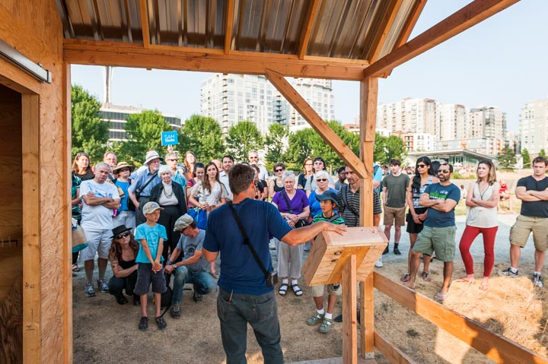
Who We Are
Our mission is to connect art to life.
Through art, the Seattle Art Museum enriches lives and engages diverse communities.
As the leading visual art institution in the Pacific Northwest, SAM draws on its global collections, powerful exhibitions, and dynamic programs to provide unique educational resources benefiting the Seattle region, the Pacific Northwest, and beyond.
Notes:
Microsoft’s commitment to philanthropy is embedded in our mission of empowering every person and every organization on the planet to achieve more.
Microsoft has an enduring commitment to fulfilling our public responsibilities and serving the needs of people in communities worldwide. We are a responsible global corporate citizen. We build and maintain the trust of our customers, consumers, partners, and shareholders.
Every interaction we have – whether it is meeting with a partner, talking to your neighbor, talking to a stranger at the coffee shop – every instance is an opportunity to uphold our mission and core values…or detract from them.
Since the Philanthropies group was created last December, and we’ve been developing our plans to increase our work with nonprofits, we’ve worked with the Boston Consulting Group and conducted a number of focus groups.
We wanted to share some of the nonprofit focus group feedback with you to help you ensure that both you and any nonprofit partners you are working with have a positive experience during the Hack for Good Challenge.

Slide 3
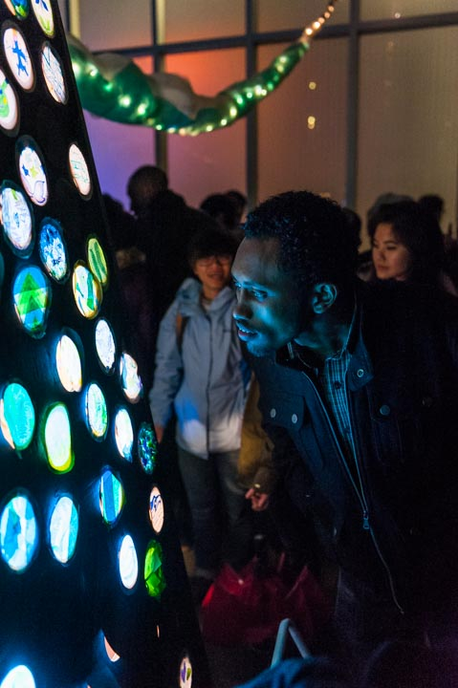
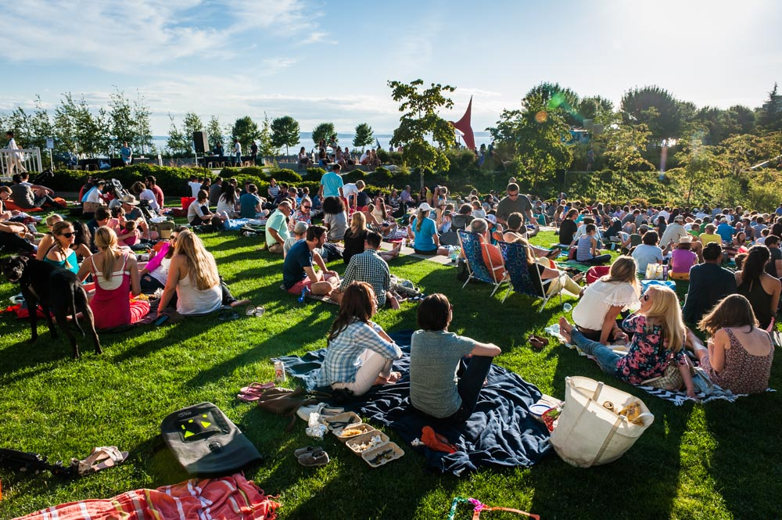
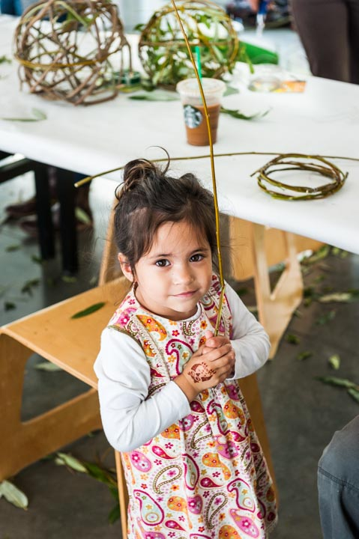
Notes:
Microsoft’s commitment to philanthropy is embedded in our mission of empowering every person and every organization on the planet to achieve more.
Microsoft has an enduring commitment to fulfilling our public responsibilities and serving the needs of people in communities worldwide. We are a responsible global corporate citizen. We build and maintain the trust of our customers, consumers, partners, and shareholders.
Every interaction we have – whether it is meeting with a partner, talking to your neighbor, talking to a stranger at the coffee shop – every instance is an opportunity to uphold our mission and core values…or detract from them.
Since the Philanthropies group was created last December, and we’ve been developing our plans to increase our work with nonprofits, we’ve worked with the Boston Consulting Group and conducted a number of focus groups.
We wanted to share some of the nonprofit focus group feedback with you to help you ensure that both you and any nonprofit partners you are working with have a positive experience during the Hack for Good Challenge.

Slide 4
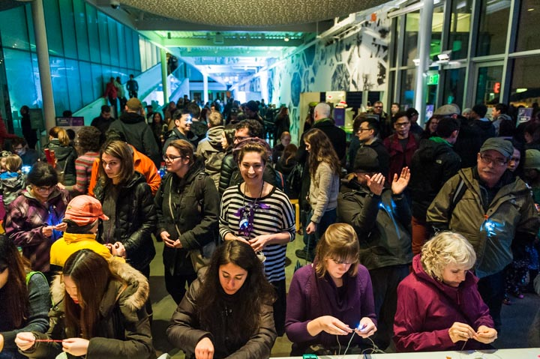
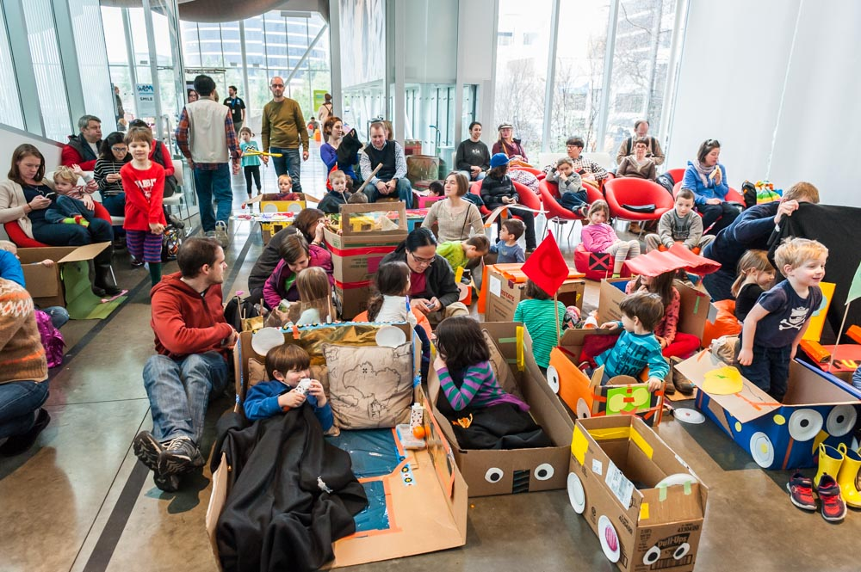
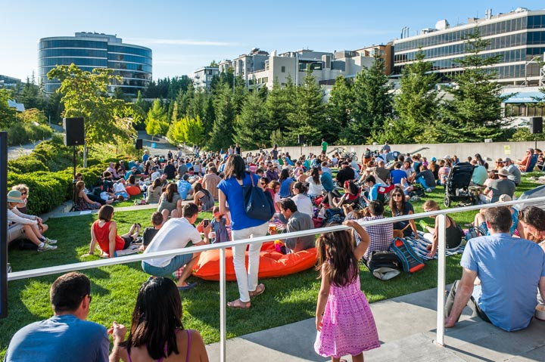
WHO ARE ALL THESE PEOPLE?

Slide 5
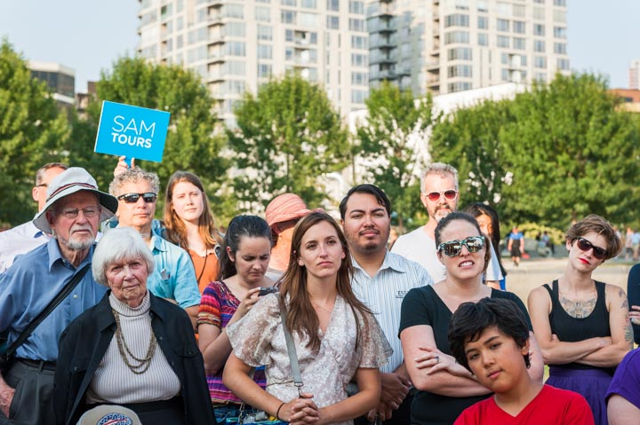
Our Challenge
While we engage large and diverse audiences, we know very little about who they are.
This is especially true at large, free programs like at the Olympic Sculpture Park where it is difficult to accurately quantify the number of attendees.
We have limited resources to understand who they are, their needs, and their preferences to maximize the creation of engaging, relevant, meaningful programming.
Notes:
Microsoft’s commitment to philanthropy is embedded in our mission of empowering every person and every organization on the planet to achieve more.
Microsoft has an enduring commitment to fulfilling our public responsibilities and serving the needs of people in communities worldwide. We are a responsible global corporate citizen. We build and maintain the trust of our customers, consumers, partners, and shareholders.
Every interaction we have – whether it is meeting with a partner, talking to your neighbor, talking to a stranger at the coffee shop – every instance is an opportunity to uphold our mission and core values…or detract from them.
Since the Philanthropies group was created last December, and we’ve been developing our plans to increase our work with nonprofits, we’ve worked with the Boston Consulting Group and conducted a number of focus groups.
We wanted to share some of the nonprofit focus group feedback with you to help you ensure that both you and any nonprofit partners you are working with have a positive experience during the Hack for Good Challenge.

Slide 6
Why It Matters
Education & Public Programs are one of our most visible and accessible ways we connect Art to Life for the Seattle community.
With a wide variety of programs, we strive to make art not only an engaging and fulfilling experience, but also strive to make art and our collection accessible to communities.
If we knew a little more about our audiences, we will be able to:
1) provide for more relevant outreach
2) create more positive visitor experiences
3) better fundraise for our programming
Notes:
Microsoft’s commitment to philanthropy is embedded in our mission of empowering every person and every organization on the planet to achieve more.
Microsoft has an enduring commitment to fulfilling our public responsibilities and serving the needs of people in communities worldwide. We are a responsible global corporate citizen. We build and maintain the trust of our customers, consumers, partners, and shareholders.
Every interaction we have – whether it is meeting with a partner, talking to your neighbor, talking to a stranger at the coffee shop – every instance is an opportunity to uphold our mission and core values…or detract from them.
Since the Philanthropies group was created last December, and we’ve been developing our plans to increase our work with nonprofits, we’ve worked with the Boston Consulting Group and conducted a number of focus groups.
We wanted to share some of the nonprofit focus group feedback with you to help you ensure that both you and any nonprofit partners you are working with have a positive experience during the Hack for Good Challenge.

Slide 7
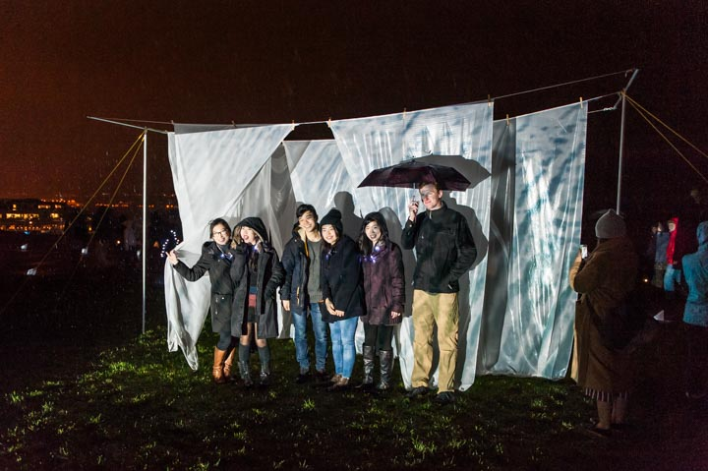
Skills Most Needed
Collecting and interpreting data
Creative technical expertise to create and deploy what is needed for data collection for all audiences (this may mean audiences with little to no access to technology, i.e. smartphones)
Resources Available
SAM has an IT staff to provide and procure hardware, software, or infrastructure resources, as well as an Education & Public Programs team that can help provide information needed for this project.
Notes:
Microsoft’s commitment to philanthropy is embedded in our mission of empowering every person and every organization on the planet to achieve more.
Microsoft has an enduring commitment to fulfilling our public responsibilities and serving the needs of people in communities worldwide. We are a responsible global corporate citizen. We build and maintain the trust of our customers, consumers, partners, and shareholders.
Every interaction we have – whether it is meeting with a partner, talking to your neighbor, talking to a stranger at the coffee shop – every instance is an opportunity to uphold our mission and core values…or detract from them.
Since the Philanthropies group was created last December, and we’ve been developing our plans to increase our work with nonprofits, we’ve worked with the Boston Consulting Group and conducted a number of focus groups.
We wanted to share some of the nonprofit focus group feedback with you to help you ensure that both you and any nonprofit partners you are working with have a positive experience during the Hack for Good Challenge.

Slide 8
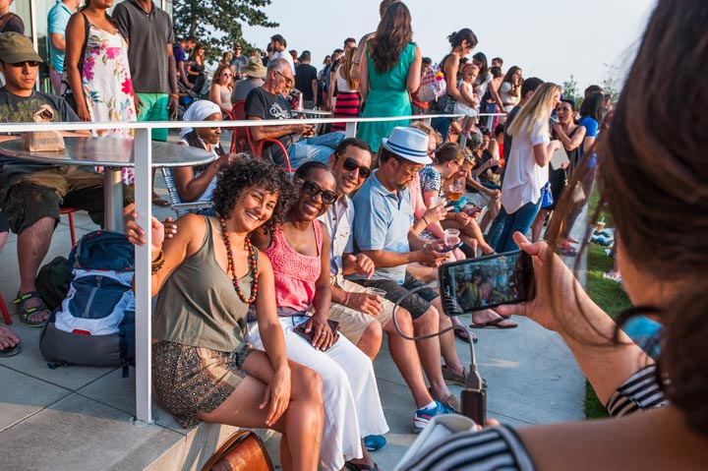
Call To Action
Help us better understand our visitors, so we can deepen our engagement and find better, more meaningful ways to connect art to life.
This may include automated ways of head counting, or seamless ways of collecting demographics, but we’re open to ideas!
Notes:
Microsoft’s commitment to philanthropy is embedded in our mission of empowering every person and every organization on the planet to achieve more.
Microsoft has an enduring commitment to fulfilling our public responsibilities and serving the needs of people in communities worldwide. We are a responsible global corporate citizen. We build and maintain the trust of our customers, consumers, partners, and shareholders.
Every interaction we have – whether it is meeting with a partner, talking to your neighbor, talking to a stranger at the coffee shop – every instance is an opportunity to uphold our mission and core values…or detract from them.
Since the Philanthropies group was created last December, and we’ve been developing our plans to increase our work with nonprofits, we’ve worked with the Boston Consulting Group and conducted a number of focus groups.
We wanted to share some of the nonprofit focus group feedback with you to help you ensure that both you and any nonprofit partners you are working with have a positive experience during the Hack for Good Challenge.

Slide 9
Thank you!
Philip Nadasdy PhilipN@SeattleArtMuseum.org
Tim Rager TimR@SeattleArtMuseum.org
www.seattleartmuseum.org

